Slide 1

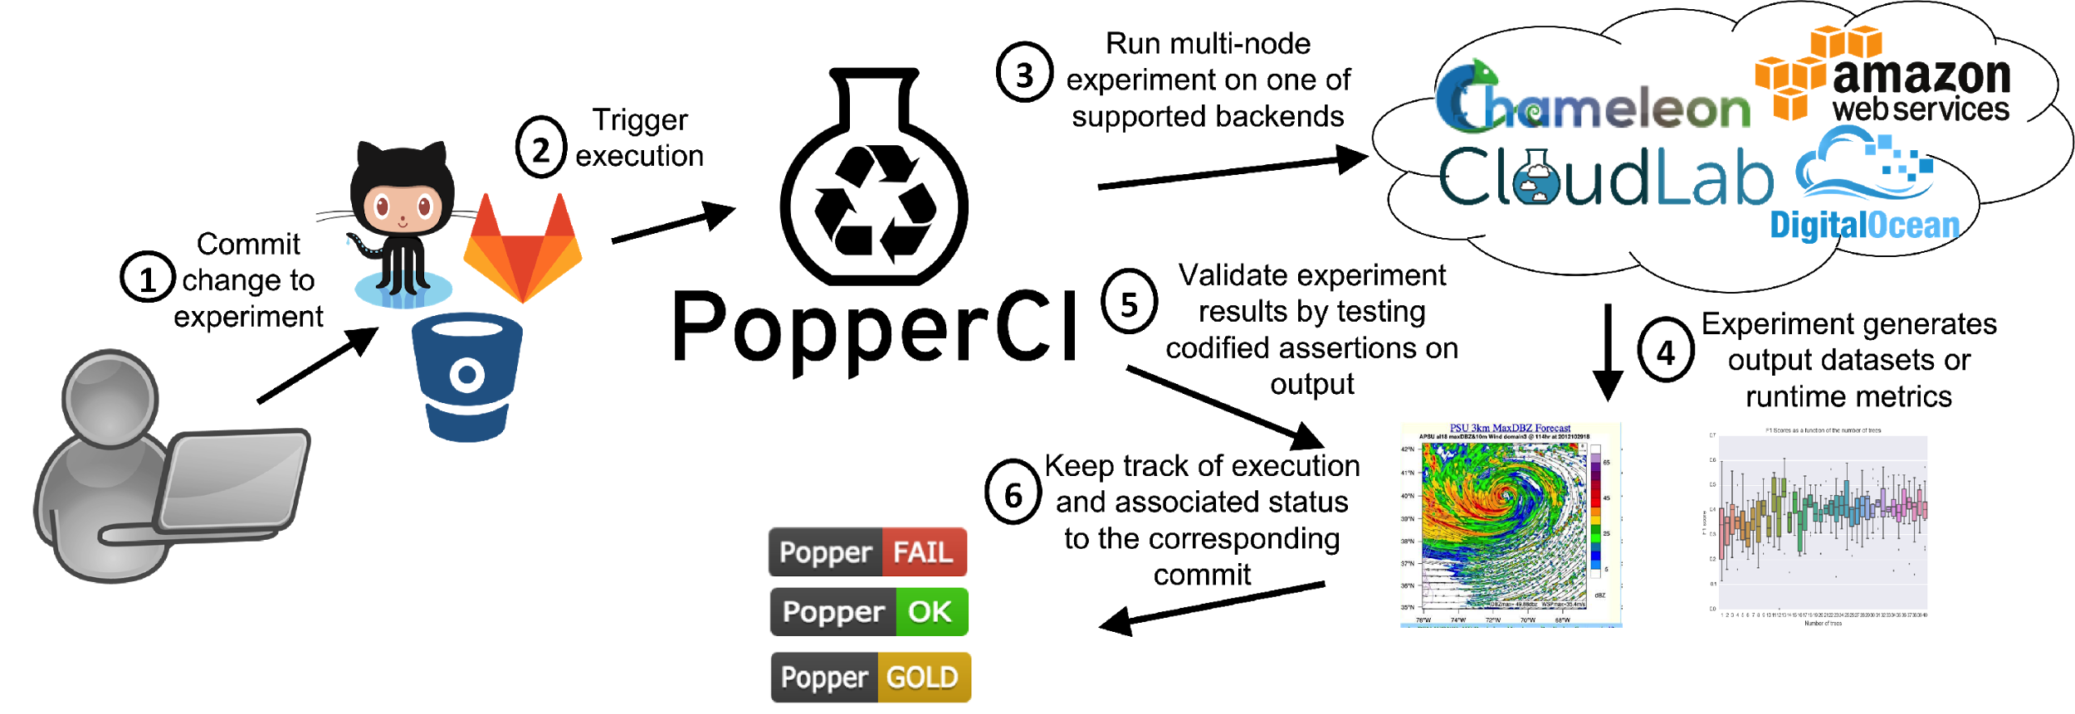


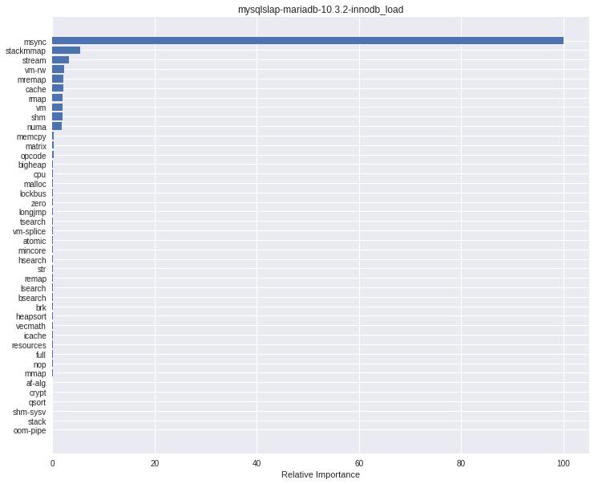
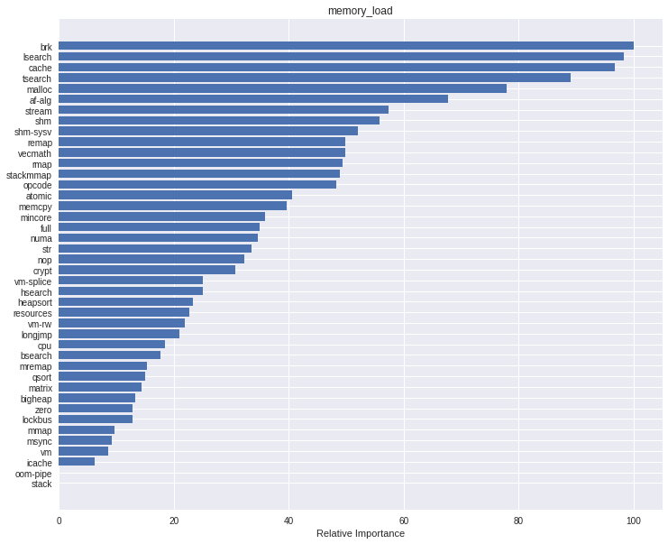
Run regression tests
Identify whether a regression occurred
by automatically comparing FGRUPs
4
5
Find root cause of regression

Slide 2
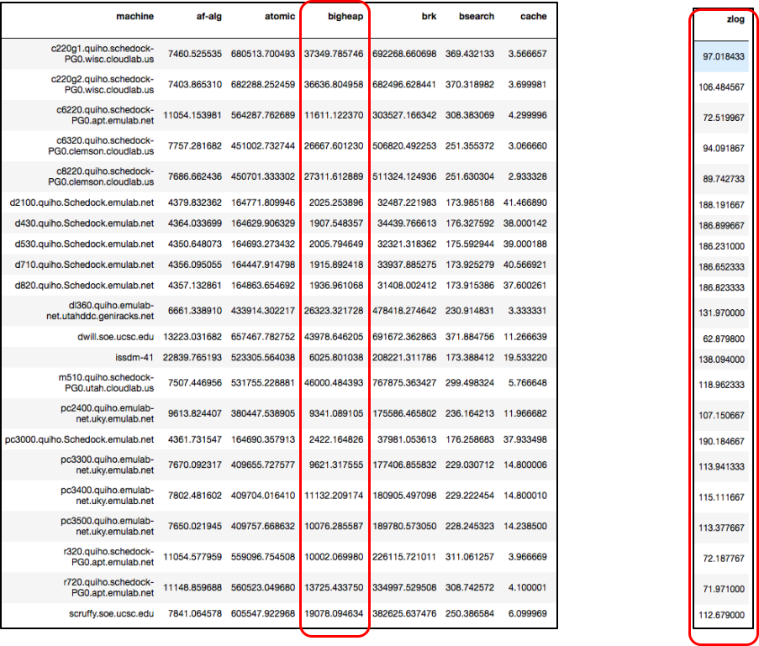
Variability patterns for a feature (across multiple machines), resembles the same variability pattern of application performance (across the same machines).

Slide 3
Run regression tests
Identify whether a regression occurred
by automatically comparing FGRUPs
4
5
Find root cause of regression

Slide 4
Obtain dataset of stress-ng performance vectors for each machine, as well as the performance vector corresponding to the application
2
3
Create a prediction model via sklearn’s gradient boosting. This produces a tree ensemble.
X
y
1
Execute stress-ng on all available machines, as well as the application being profiled.
4
Create the FGRUP by obtaining the relative ranking of feature importance out of the ensemble.

